Slide 1
Assignment – Gradient Boosting
Submitted By: Pooran Pragnya
November Batch (BDS)

Slide 2
Ensemble Technique:
It is a technique which uses multiple weak learners to produce a strong model for regression and classification problems.
It uses multiple learning algorithm to obtain better predictive performance than could be obtained from any of the constituent learning algorithm alone.
These methods help in reducing the variance and bias in ML.
Methods of Ensemble techniques are Boosting, Bagging and Stacking.

Slide 3
Boosting :
Building multiple models (typically of same type) each of which learners to fix the prediction errors of a prior model in the sequence of models.
It is an ensemble modelling technique that attempts to build a strong classifier from the number of weak classifier.
Methodology: firstly a model is built from training the data, then the second model is built which tries to correct the errors present in the first model. This procedure is continued and models are added until either the complete training dataset is predicted correctly or the maximum number of models are added.

Slide 4
Types of Boosting
1. Adaptive Boosting or AdaBoost
2. Gradient Boosting
3. XG Boost/Extreme Gradient Boosting

Slide 5
1. Adaptive Boosting
It was first really successful boosting algorithm developed for the purpose of binary classification.
Ada Boost is implemented by combining several weak learners into a single strong learners.
The weak learners in Ada Boost take into account a single input feature and draw out a single split decision tree called the Decision Stump. Each observation is weighed equally while drawing out the first decision stump.
AdaBoost can be used for both classification and regression based problems, however it is more commonly used for classification purpose.

Slide 6
2. Gradient Boosting
It is a type of ensemble technique used in supervised ML algorithm which is used for both classification as well as regression problems.
It is popular boosting algorithm.
In gradient boosting, each predictor corrects its predecessors error.
Here, each predictor is trained using the residual errors of predecessor as labels.
Here, the base learners are generated sequentially in such a way that the present base learner is always more effective than the previous one i.e the overall model improves sequentially with each iteration.

Slide 7
Main Components of Gradient Boosting
1. Loss Function (Intuition)
2.Weak Learners.
3.Additive Model

Slide 8
Loss Function:
Gradient Boosting relies on the intuition (ability to understand something instantly, without the need for conscious reasoning) that the best possible next model. When combined with the previous models, minimizes the overall prediction errors. The key idea is to set the target outcomes from the previous models to the next model in order to minimize the errors.

Slide 9
Weak Learners
Weak learners are the Models which are used sequentially to reduce the error generated from the previous models and to return a strong model on the end.
Decision tree are used as weak learners in gradient boosting algorithm.
Additive Model
In gradient boosting decision trees are added one at a time (in sequence) and existing trees in the model are not changed.
It is a model that will regularize the lass function.

Slide 10
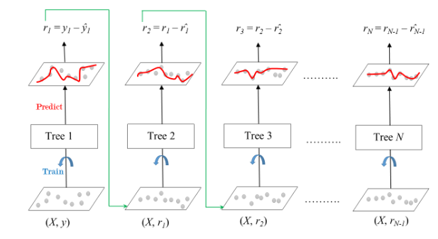
There is a technique called Gradient Boosted Trees whose base learners is CART (Classification and Regression Trees).

Slide 11
Here,
Each Tree Predicts a label and final prediction is given by the formula:
Y1 : Average,
r1, r2…. rn : Residual of models 1,2…. n
Error from First Model > Errors from Second Model > Errors from Third Model
Y (Pred) = Y1 + (eta * r1) + (eta * r2) +………+(eta * rn)
Y (Pred) = Average Price + Learning Rate * Residual Predicted by Decision tree

Slide 12
Steps involved:
1. Find the average of the label.
2. calculate the residual for each sample (Residual = Actual value – Average value).
3. Residual calculated will be taken as label for the next model and model will be trained and process continues.
4. Repeat the steps 3 to 5 times until the number of iterations matches the number specified by the hyperparameter (No. of estimators).
5. once trained, use all the trees in ensemble to make a final prediction as to value of the target variable. The final prediction will be equal to the mean we computed in step 1plus all the residual predicted by the trees that make up the forest multiplied by the learning rate.

